Slide 1
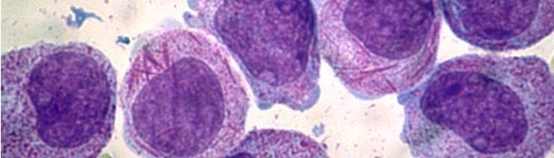
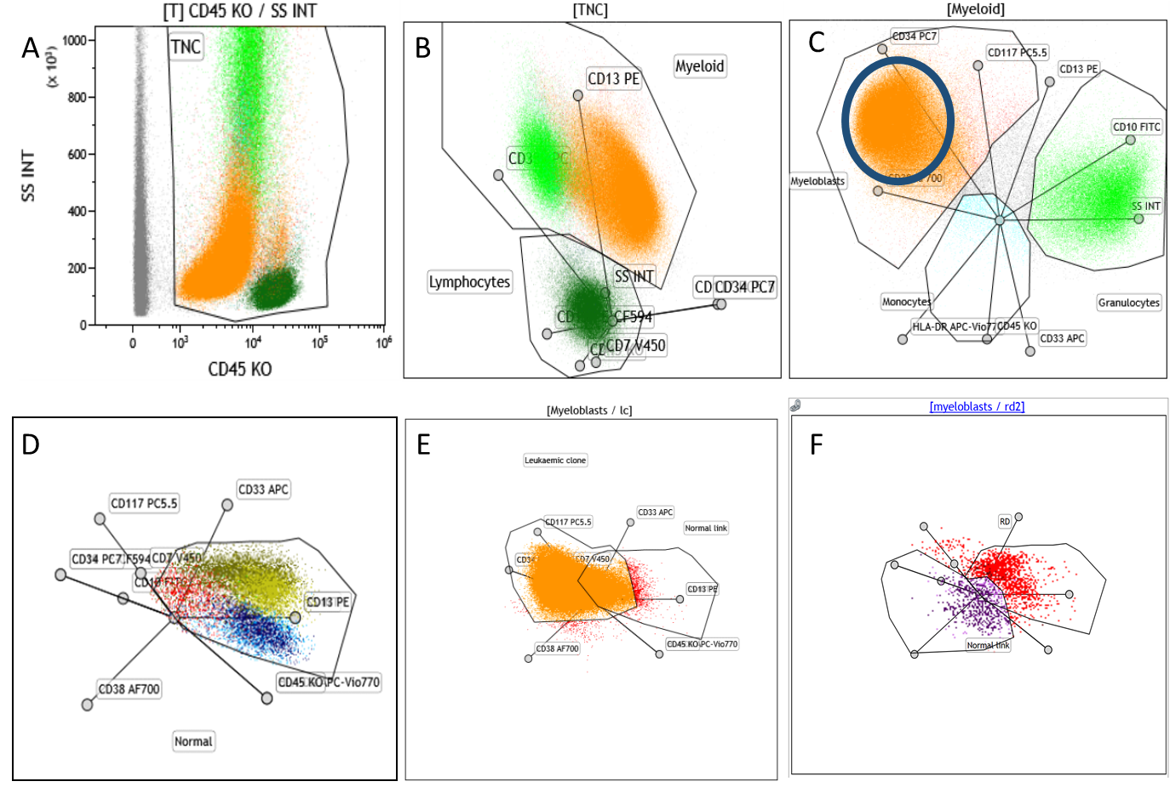
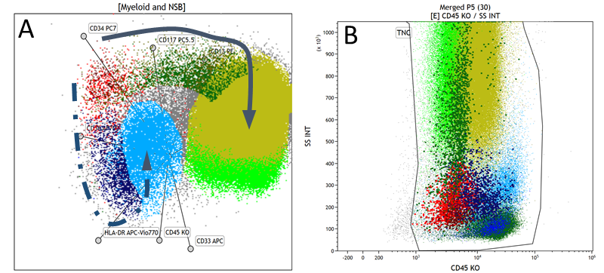
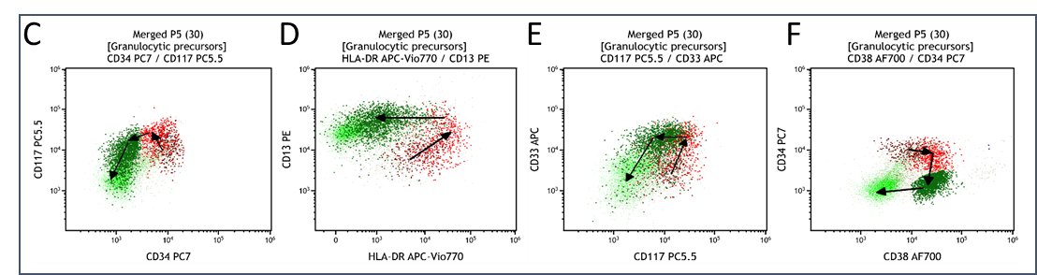
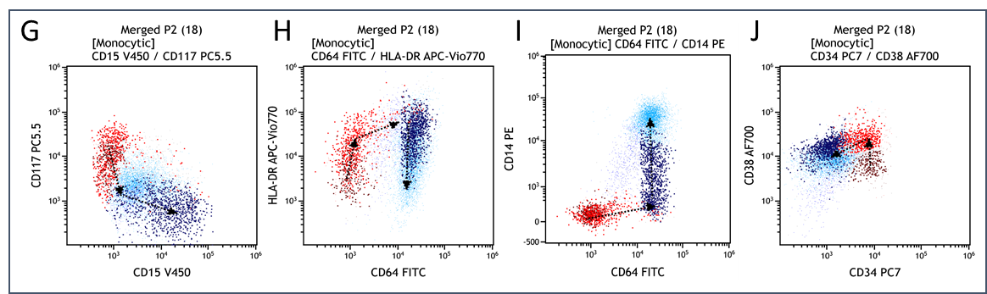
Validation of an Acute Myeloid Leukaemia
Measurable Residual Disease flow cytometric analysis method using Kaluza software and multidimensional radar plots
Riana van der Linde¹, Sandy Smith¹, Sarah C Sasson¹, David Brown¹, Elizabeth Tegg¹
1NSW Health Pathology, Sydney, Australia
Introduction
Acute myeloid leukaemia (AML) is a haematological malignancy characterised by a sudden increase of immature myeloid cells. In 2014 the WHO estimated the world-wide prevalence to be around 1.5%.¹ The outcome for these patients remain bleak despite recent advances in management. Currently 60-80% of adults younger than 60 years achieve complete remission with induction therapy, while the rates for those older than 60 years are lower at 40 to 60%. Overall, 40% of patients will relapse.² Improvements in diagnostics and treatment have led to an increased requirement for accurate and sensitive tests to detect measurable residual disease (MRD).³ MRD can be measured by either molecular methods or by multiparameter flow cytometry (MFC). MFC remains an essential tool for MRD analysis since only around 40 - 50% of adults have a measurable molecular marker.⁴ We hypothesised that the use of multidimensional radar plots for flow cytometric analysis would reduce the effect that phenotypic changes have on MRD analysis. If the method is found to be fit for purpose, we will aim for implementation into the clinical laboratory. We are also currently conducting a prospective study investigating the outcome of patients based on their MRD status during and after treatment.
Method
Create a template to analyse AML samples utilising multidimensional radar plots in Kaluza software.
Normal maturation patterns identified using presumed normal marrows for both our myeloid (n=30) and monocytic (n=18) panels. (Fig 1&2)
Validation by comparing the results to the current method, and where available, to the molecular MRD result.
80 consecutive adult samples received for AML MRD by flow cytometry were analysed.
The radar plot method were compared to the current analysis method. (n=80)
The flow cytometry methods were compared to the molecular methods, where available. (n=25)
Agreement were calculated with Cohen’s Kappa and McNemar statistical analysis methods.
Results
Radar plot method vs current method
Comparison of the current analysis method and radar plot method (Table 1) showed a moderate correlation (k = 53%) with no significant difference between the two methods (p = 0.16).
Thirteen tests were positive using the radar plot method and negative with our current method. 10/13 had low level MRD, between 0.1% and 0.01%. (Table 2) Only two of the ten cases had a recurrent genetic marker, MRD41 and MRD9. The were respectively positive for t(8;21) by RQ-PCR and t(3;5) in a single cell, by cytogenetics.
Six patients were positive with the current method, but negative with the radar plot method.
Table 1: Comparison of radar plot method to current analysis method. (k=53%, p=0.16)
Table 2: Comparison of radar plot method, current analysis method and molecular MRD between 0.01 and 0.1%
Flow cytometry methods vs molecular methods
Comparison of the radar plot method (Table 3) to molecular MRD results (n=25) showed a fair agreement and no significant difference between the groups (k=30%; p=0.182).
Two cases were positive by the molecular method, but negative with both flow methods. Both cases had a very low level molecular MRD, 0.0008% and 0.0013%, respectively. Seven cases were positive by both flow cytometry methods, but negative using molecular methods.
Table 3: Comparison of radar plot method to molecular MRD (k=30%, p=0.182)
Table 4: Comparison of radar plot method, current analysis method and molecular MRD
Conclusion
There is a moderate agreement between the two flow cytometry analysis methods, suggesting the radar plot method is fit for purpose. The clustering of discrepant results with low-level MRD may indicate that the radar plot method is more sensitive to small abnormal populations. Confirmation of this finding is necessary and will be further evaluated with the larger prospective study.
There was notable differences with the molecular methods. This may be due to the increased sensitivity of molecular tests, true discrepant results due to the well-known propensity of AML to form subpopulations or non-leukaemic myeloid populations that confound MRD result interpretation.⁵
The next steps are to implement this analysis method into the diagnostic laboratory and evaluation of the prospective study.
References:
World Health Organization. 2014 Review of Cancer Medicines on the WHO List of Essential Medicines. Available at: http://www.who.int/selection_medicines/committees/ expert/20/applications/AML_APL.pdf. Accessed on April 01, 2021
Zeijlemaker W, Gratama JW, Schuurhuis GJ. Tumor heterogeneity makes AML a "moving target" for detection of residual disease. Cytometry B Clin Cytom 2014; 86(1):3–14.
Chen X, Wood BL. Monitoring minimal residual disease in acute leukemia: Technical challenges and interpretive complexities. Blood Rev 2017; 31(2):63–75.
Coustan-Smith E, Song G, Shurtleff S, Yeoh AE-J, Chng WJ, Chen SP et al. Universal monitoring of minimal residual disease in acute myeloid leukemia. JCI Insight 2018; 3(9).
Li W, Morgan R, Nieder R, Truong S, Habeebu SSM, Ahmed AA. Normal or reactive minor cell populations in bone marrow and peripheral blood mimic minimal residual leukemia by flow cytometry. Cytometry B Clin Cytom 2020.
Molecular
 | Negative | Positive
Negative | 7 | 2 | 9
Positive | 7 | 9 | 16
 | 14 | 11 | 25
Radar
Figure 2. Example: Newly diagnosed AML.
Instead of using the traditional CD45/SS plot (A) to identify the blasts a radar plot is used to separate the myeloid and lymphoid cells (B) and then identify the leukaemic blast population within the myeloid population (C).​
We then create a unique configuration, using a radar plot containing all the parameters in the panel, to separate the leukaemic blasts from the area where normal precursors are expected to occur. (D&E). This unique configuration can then be used in subsequent MRD analysis (F). Residual disease seen in dark purple.
Dark green: Lymphocytes, Bright green: Granulocytes, Light blue: Monocytes, Dark blue: Promonocytes, Red: Myeloblasts, Orange: Leukaemic clone, Dark purple: Residual disease.
 | Genetic | Radar | Current | Molecular | New | Current | Molecular
MRD16 | t(8;21) | 0.00% | 0.00% | 0.0000% | Neg | Neg | Neg
MRD19 | t(8;21) | 0.00% | 0.00% | 0.0000% | Neg | Neg | Neg
MRD21 | Inv 16 | 0.00% | 0.00% | 0.000% | Neg | Neg | Neg
MRD24 | NPM1 | 0.00% | 0.00% | 0.0000% | Neg | Neg | Neg
MRD25 | t(8;21) | 0.00% | 0.00% | 0.0000% | Neg | Neg | Neg
MRD40 | Inv 16 | 0% | 0.00% | 0.000% | Neg | Neg | Neg
MRD49 | NPM1 | 0% | 0.46% | 0.0000% | Neg | Pos | Neg
MRD76 | NPM1 | 0.03% | 0.07% | 0.0000% | Pos | Pos | Neg
MRD53 | NPM1 | 0.05% | 0.05% | 0.0000% | Pos | Pos | Neg
MRD77 | NPM1 | 0.09% | 0.25% | 0.0000% | Pos | Pos | Neg
MRD54 | NPM1 | 0.17% | 0.11% | 0.0000% | Pos | Pos | Neg
MRD59 | t(8;21) | 0.24% | 0.28% | 0.0000% | Pos | Pos | Neg
MRD68 | NPM1 | 0.31% | 0.48% | 0.0000% | Pos | Pos | Neg
MRD69 | t(8;21) | 0.39% | 0.03% | 0.0000% | Pos | Pos | Neg
MRD31 | NPM1 | 0.00% | 0.00% | 0.0008% | Neg | Neg | Pos
MRD15 | t(8;21) | 0.00% | 0.00% | 0.0013% | Neg | Neg | Pos
MRD35 | NPM1 | 0.29% | 0.17% | 0.0013% | Pos | Pos | Pos
MRD46 | t(8;21) | 0.08% | 0.03% | 0.0014% | Pos | Pos | Pos
MRD58 | t(8;21) | 0.04% | 0.01% | 0.0042% | Pos | Pos | Pos
MRD41 | t(8;21) | 0.04% | 0.00% | 0.0095% | Pos | Neg | Pos
MRD73 | NPM1 | 0.04% | 0.00% | 0.0095% | Pos | Neg | Pos
MRD34 | t(8;21) | 0.23% | 0.10% | 0.0240% | Pos | Pos | Pos
MRD12 | NPM1 | 0.01% | 0.01% | 0.0490% | Pos | Pos | Pos
MRD28 | NPM1 | 0.13% | 0.00% | 0.4100% | Pos | Neg | Pos
MRD74 | NPM1 | 0.16% | 1.04% | 1.7000% | Pos | Pos | Pos
 | Negative | Positive
Negative | 27 | 6 | 33
Positive | 13 | 34 | 47
 | 40 | 40 | 80
Radar
Current
 | Genetic | Radar | Current | Molecular | New | Current | Molecular
MRD34 | t(8;21) | 0.01% | 0.01% | 0.0490% | Pos | Pos | Pos
MRD47 |  | 0.01% | 0.00% |  | Pos | Neg
MRD4 | RUNX1 | 0.02% | 0.00% |  | Pos | Neg
MRD14 | del (5q) | 0.02% | 0.02% |  | Pos | Pos
MRD26 |  | 0.02% | 0.08% |  | Pos | Pos
MRD57 |  | 0.02% | 0.00% |  | Pos | Neg
MRD30 | RUNX1 | 0.03% | 0.00% |  | Pos | Neg
MRD38 | t(3;5) | 0.03% | 0.00% |  | Pos | Neg
MRD61 | RUNX1 | 0.03% | 0.26% |  | Pos | Pos
MRD63 | RUNX1 | 0.03% | 0.05% |  | Pos | Pos
MRD76 | NPM1 | 0.03% | 0.07% | 0.0000% | Pos | Pos | Neg
MRD41 | t(8;21) | 0.04% | 0.00% | 0.0095% | Pos | Neg | Pos
MRD58 | t(8;21) | 0.04% | 0.01% | 0.0042% | Pos | Pos | Pos
MRD9 | t(3;5) | 0.05% | 0.00% | t(3;5);1/40 | Pos | Neg | Pos
MRD53 | NPM1 | 0.05% | 0.05% | 0.0000% | Pos | Pos | Neg
MRD10 | del(7) | 0.06% | 0.00% |  | Pos | Neg
MRD42 | KMT2A | 0.06% | 0.00% |  | Pos | Neg
MRD71 | KMT2A | 0.06% | 0.01% |  | Pos | Pos
MRD75 | t(6;9) | 0.06% | 0.10% |  | Pos | Pos
MRD43 |  | 0.08% | 0.00% |  | Pos | Neg
MRD46 | t(8;21) | 0.08% | 0.03% | 0.0014% | Pos | Pos | Pos
MRD77 | NPM1 | 0.09% | 0.25% | 0.0000% | Pos | Pos | Neg
Figure 1. Normal maturation patterns
Maturation of myeloid cells with good separation of granuocytic and monocytic lineages. (A,B). Normal maturation pattern for granulocytes (C-F). Normal maturation pattern for monocytes (G-H)
Dark red: Stem cells, Red: Myeloid blasts, Dark green: Promyelocytes, Khaki: Later myeloid precursors; Bright green: Mature neutrophils, Dark blue: Monocytic precursors, Light blue: Mature monocytes

